Slide 1
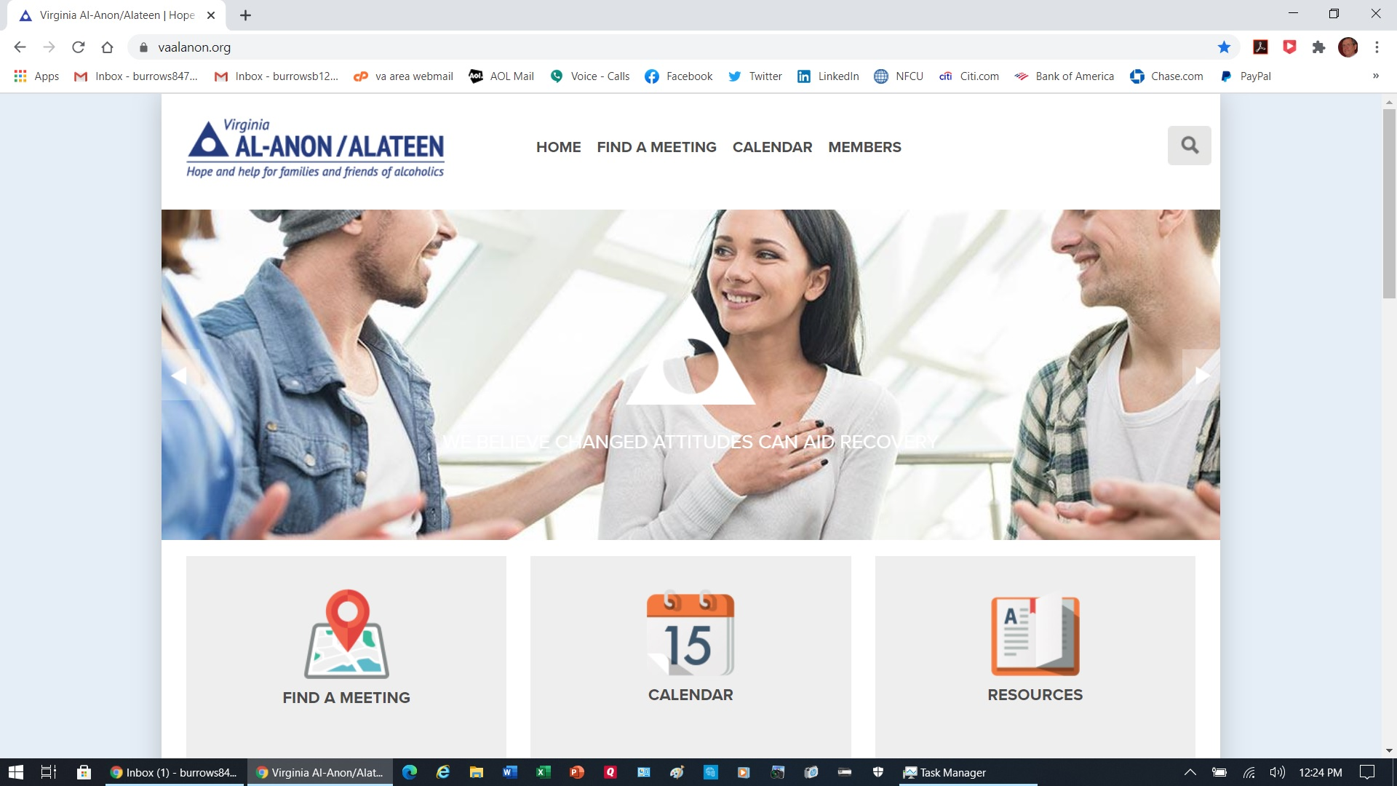
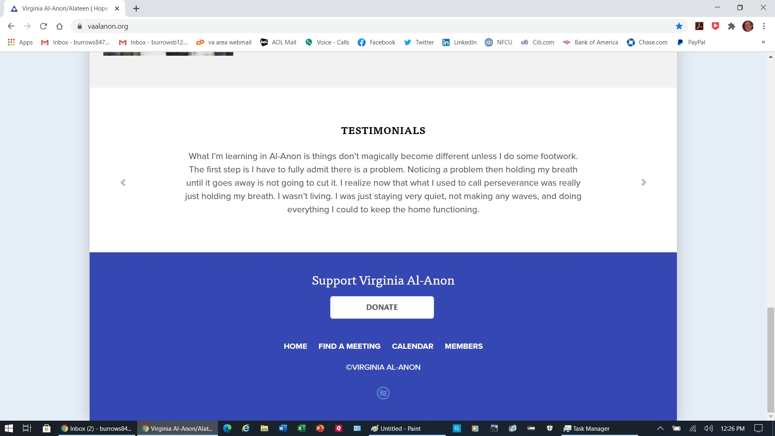
PayPal Illustration: How to Donate to the Virginia Area October 1, 2020
We recommend you use a desktop or notebook computer for clarity and simplicity. If you donate from your own PayPal account, the small PayPal fee can be avoided if you use your PayPal cash balance or if your PayPal account is linked to your bank account for payment purposes. If you see the option to send money to a friend or relative, use it. See additional information below. (At the Area, we have no preference either way.)
In your preferred web browser, go to www.vaalanon.org and scroll down to the bottom of the main page.
Scroll to the bottom of the page and click on the DONATE button.
Pg. 1 of 4

Slide 2
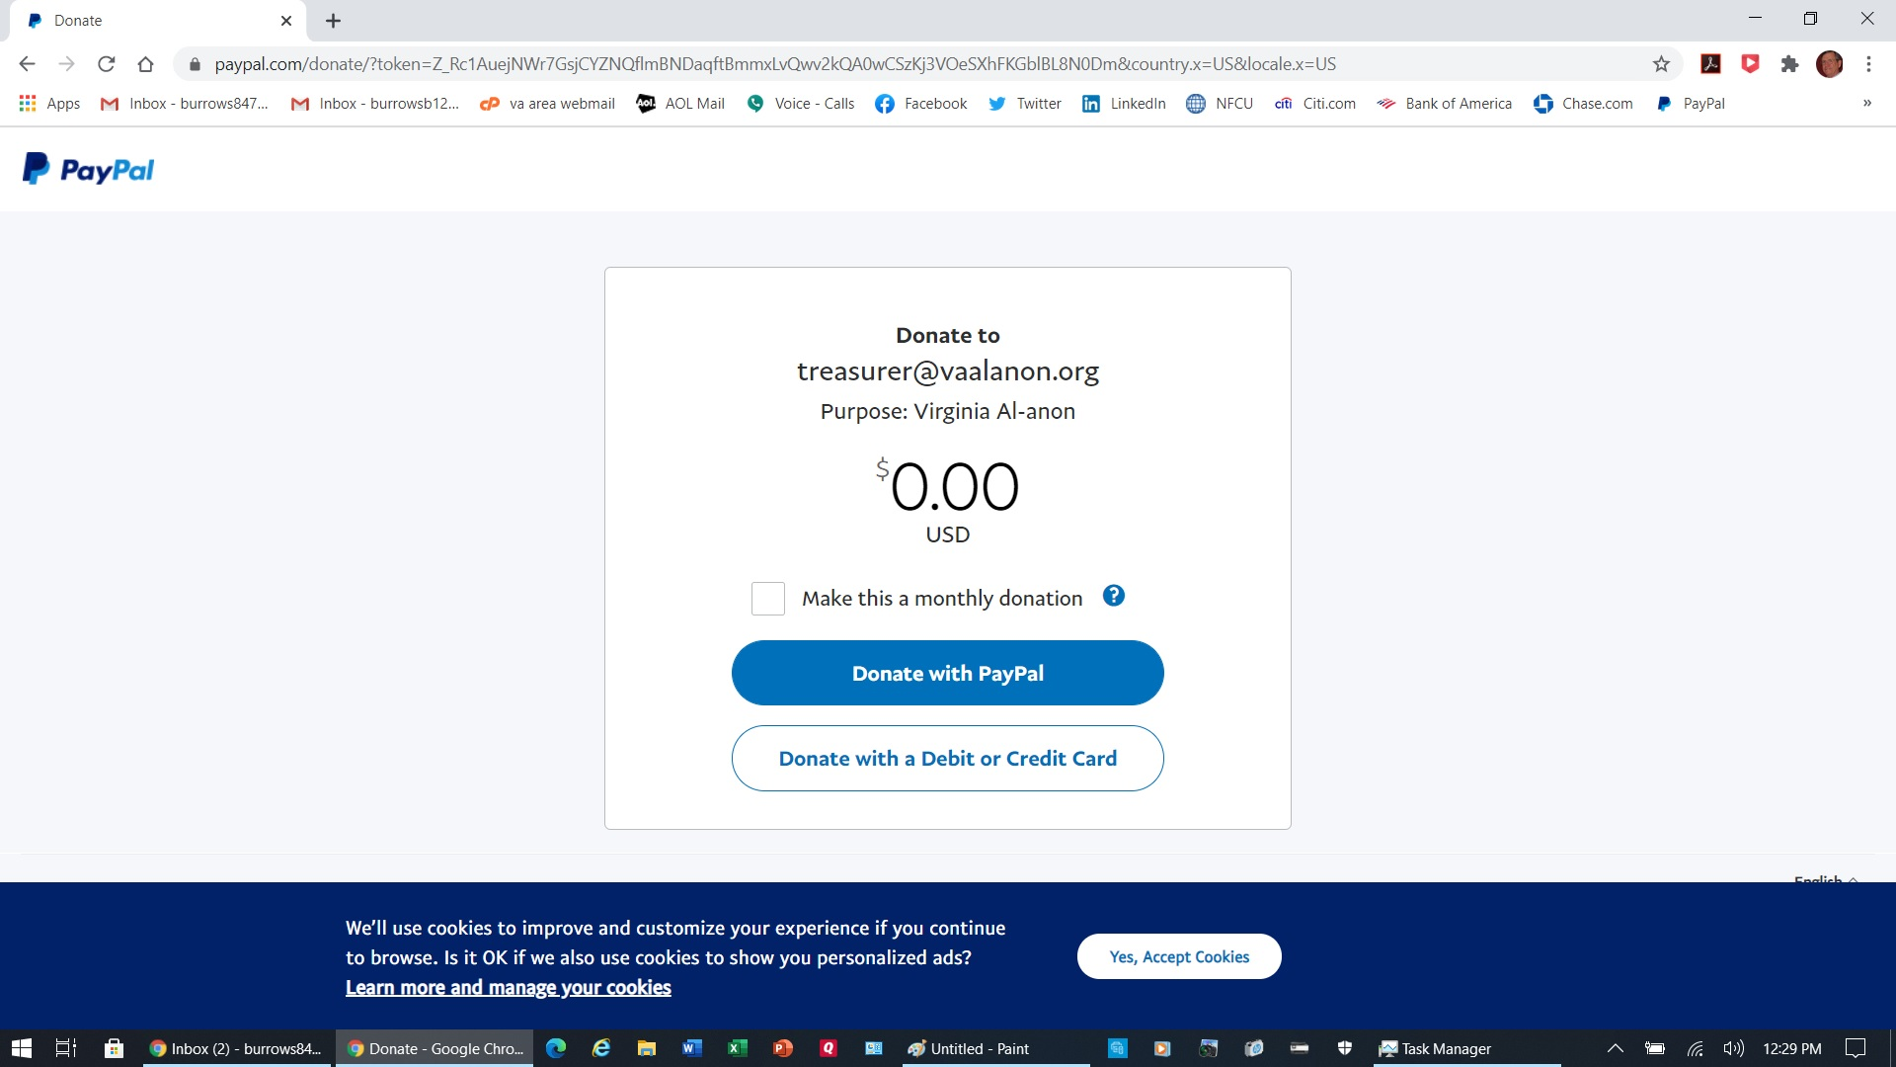
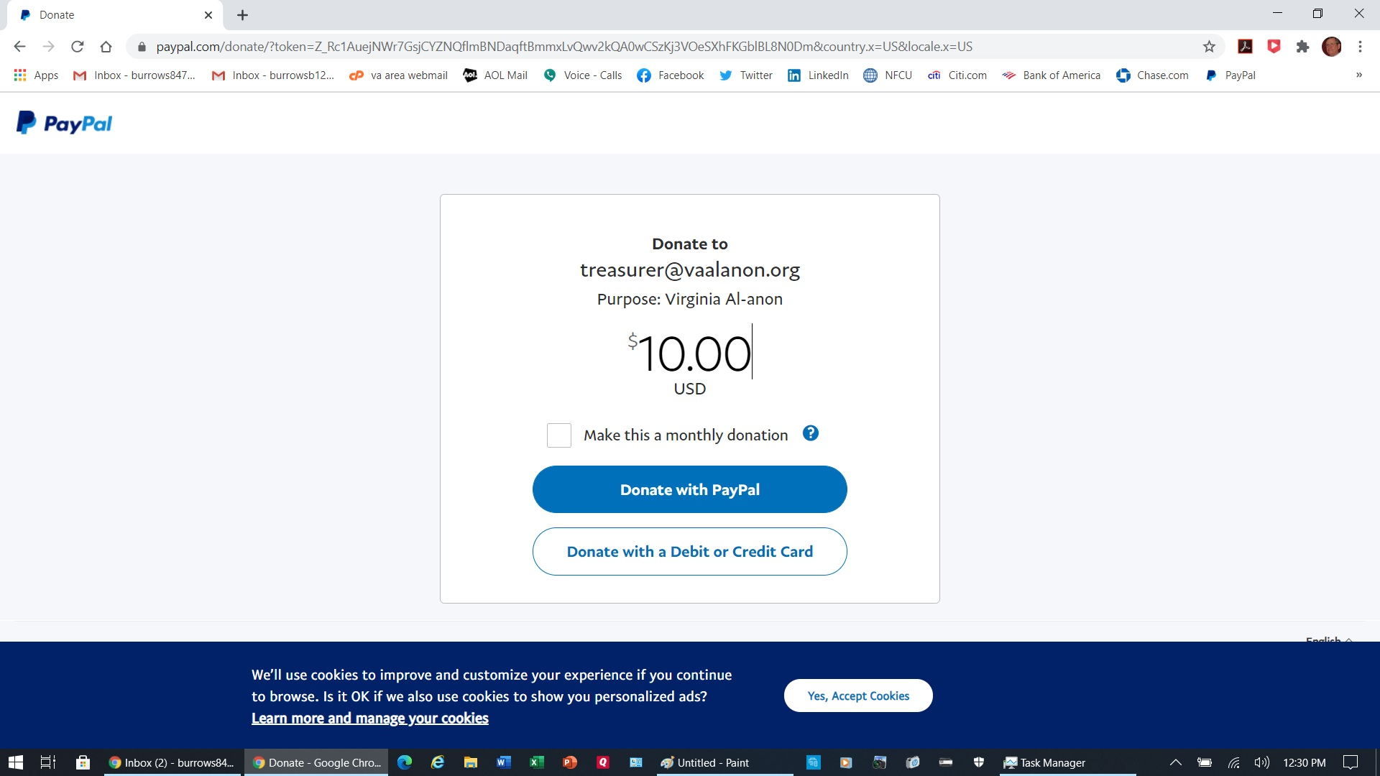
Wait a few moments for the PayPal screen to appear.
1. Enter the dollar amount you want to donate. (You can choose to make it a monthly donation.)
2. If you choose the Donate with PayPal button, you will see a screen that allows you to open your own PayPal account. Enter your PayPal user ID and password, and direct your donation to treasurer@vaalanon.org.
3. The other button will take you to the next screen (see below).
Pg. 2 of 4

Slide 3
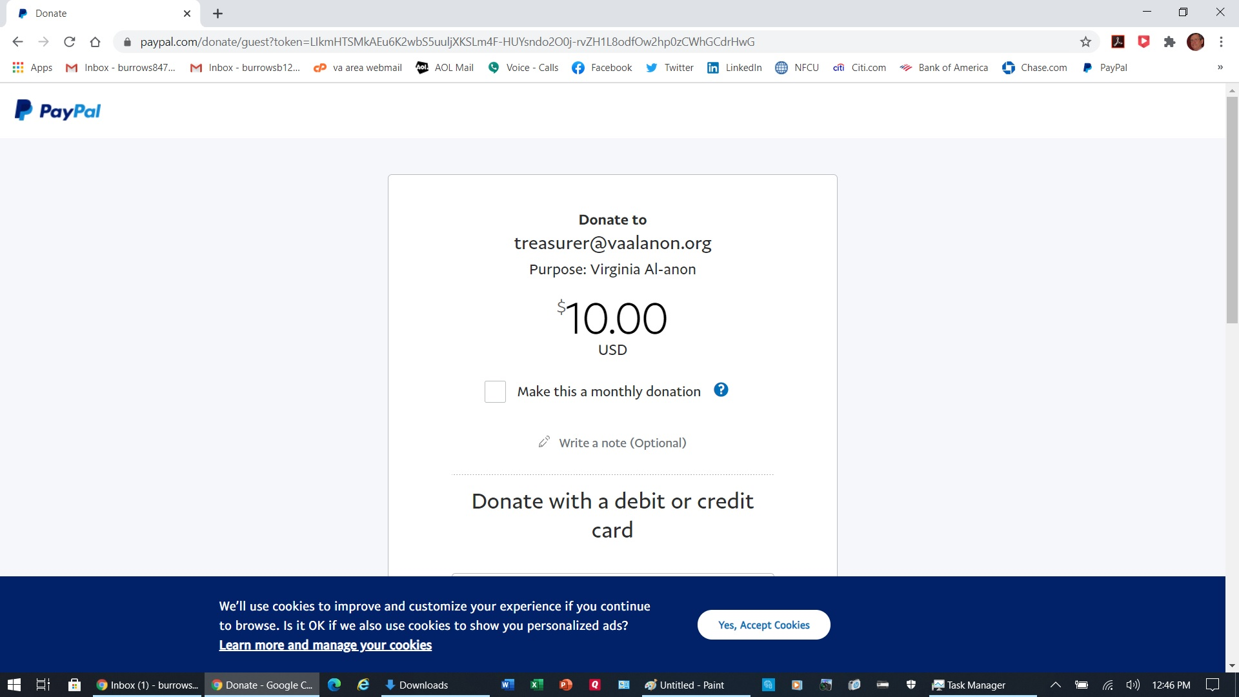
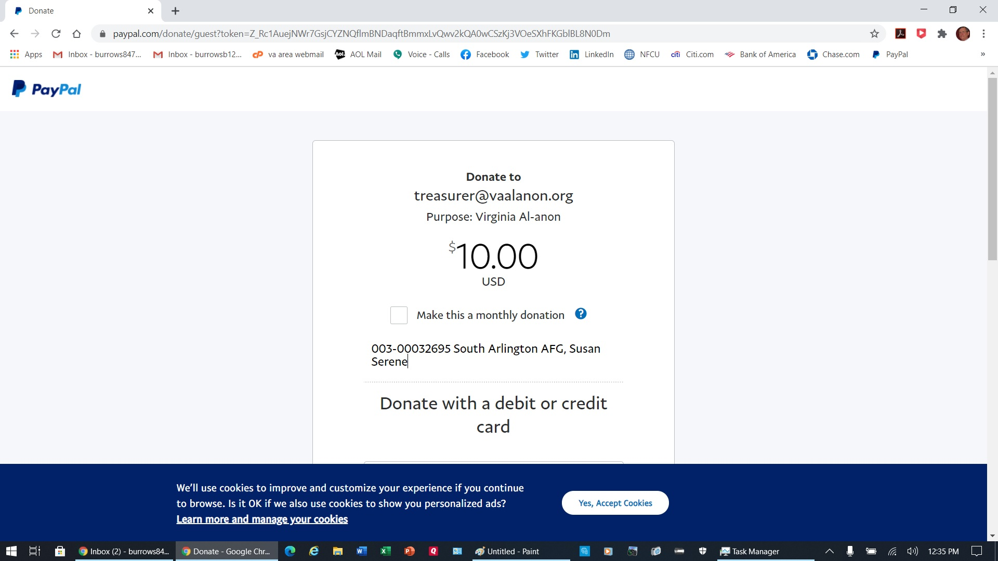
Find the words, “Write a note (Optional).”
Enter your district and group number and name. You may also enter your name if you wish. This is more important if you are making an individual donation, but it is not necessary if you prefer to remain anonymous.
Pg. 3 of 4

Slide 4
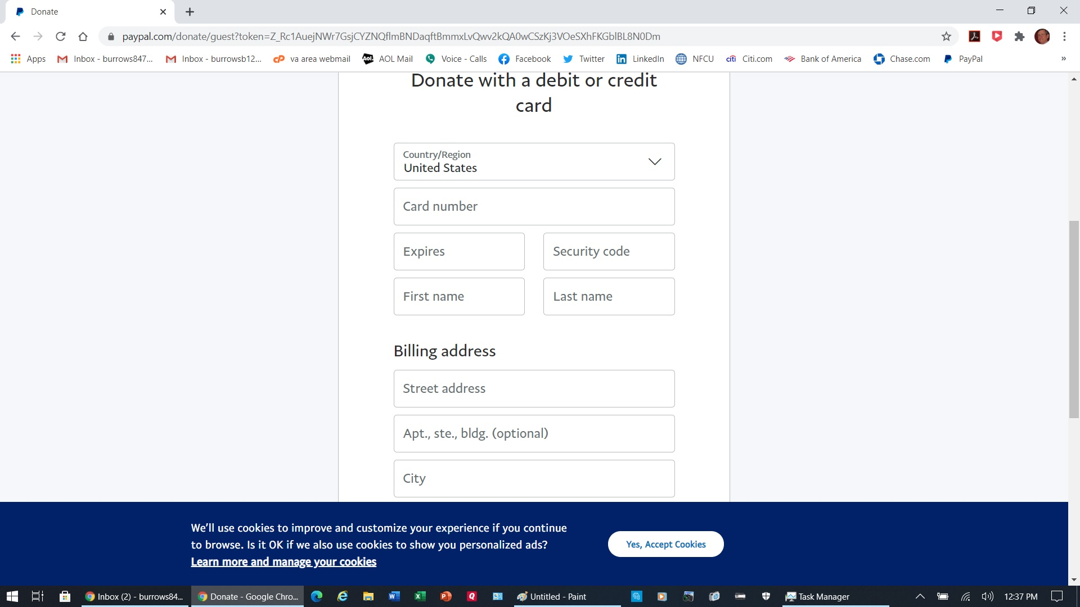
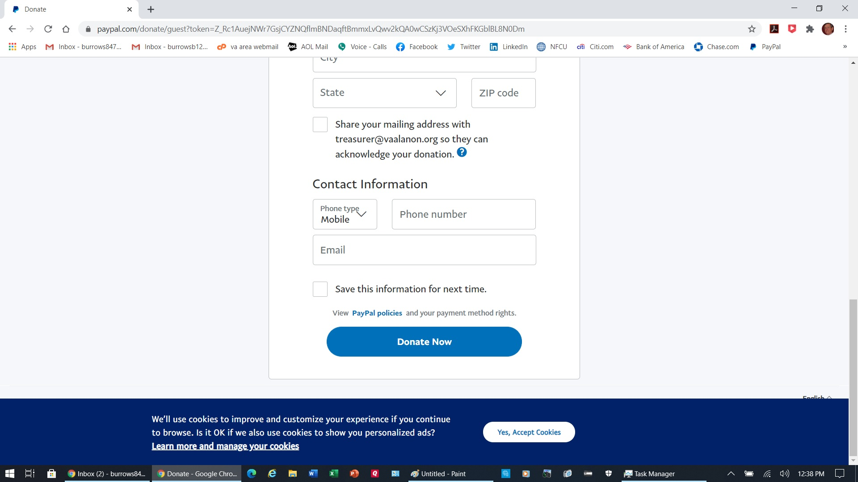
Continue to scroll down this page and enter the required information.
When you have finished entering the required information, click on the blue Donate Now button. YOU ARE DONE, and we thank you for using PayPal.
Laura Lovern
Area Treasurer
434-944-2288
Pg. 4 of 4

